Slide 1
Depi Graduation Project
Building and Securing a Small Network
Group Code: Cai1_ISS1_S1e
Team Members:
Ahmed Hossam Eldin Mohamed Ahmed Mobarak
Ahmad Alaa Eldin Abdelmoniem Sayed
Mahmoud Mohamed Mahmoud Ahmed
Ahmed Emad Ahmed Ghoneim

Slide 2
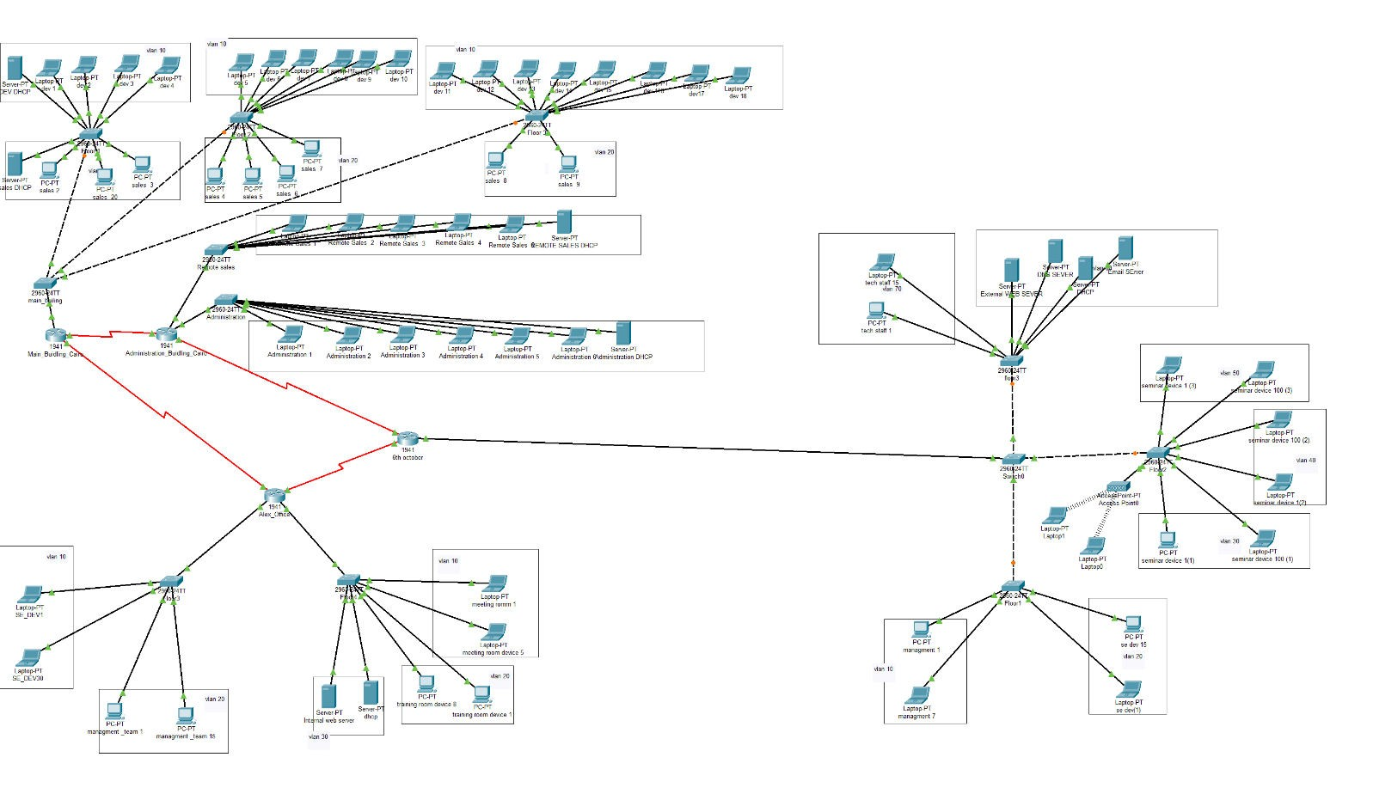
Network Design and Configuration
Network design Diagram:
Number of networks: 20
Number of Switches: 12
Number of routers:4
Number of switches that have VLANs configured: 10
Total VLANs: 13
159.10.7.0 is the network we want to subnet:

Slide 3
Class b subnetting table:
Subnet | Host | Subnet mask
1 | 65536 | /16
2 | 32768 | /17
4 | 16384 | /18
8 | 8129 | /19
16 | 4096 | /20
32 | 2048 | /21
64 | 1024 | /22
128 | 512 | /23
256 | 256 | /24
512 | 128 | /25
1024 | 64 | /26
2048 | 32 | /27
4096 | 16 | /28
8192 | 8 | /29
16384 | 4 | /30
32768 | 2 | /31
65536 | 1 | /32

Slide 4
Network Subnetting:
Network id | Subnet mask | Number of hosts | Broadcast id | Network/ department | Range of ips | Max number of available hosts | Branch
159.10.0.0 | /24 | 256 | 159.10.0.255 | Not used | 159.10.0.1- 159.10.0.254 | 254 | ..
159.10.1.0 | /24 | 256 | 159.10.1.255 | Not used | 159.10.1.1- 159.10.1.255 | 254 | ..
.. | .. | .. | .. | .. | .. | .. | ..
159.10.7.0 | /24 | 256 | 159.10.7.255 | Seminar room 1 | 159.10.7.1- 159.10.7.254 | 254 | ₆th October
159.10.8.0 | /26 | 64 | 159.10.8.63 | Software Dev | 159.10.8.1- 159.10.8.62 | 62 | Alex – VLAN
159.10.8.64 | 255.255.255.192 | 64 | 159.10.8.127 | R&D | 159.10.8.65- 159.10.8.126 | 62 | Cairo – VLAN
159.10.8.128 | /27 | 32 | 159.10.8.159 | Software Dev | 159.10.8.129- 159.10.8.158 | 30 | ₆th October
159.10.8.160 | 255.255.255.224 | 32 | 159.10.8.191 | Sales and Marketing | 159.10.8.161- 159.10.8.190 | 30 | Cario
159.10.8.192 | /27 | 32 | 159.10.8.223 | Management team | 159.10.8.193- 159.10.8.222 | 30 | Alex
159.10.8.224 | /27 | 32 | 159.10.8.255 | Tech Staff | 159.10.8.225- 159.10.8.254 | 30 | ₆th October
159.10.9.0 | 255.255.255.240 | 16 | 159.10.9.15 | Administration | 159.10.9.1- 159.10.9.14 | 14 | Cario
159.10.9.16 | /28 | 16 | 159.10.9.31 | Remote Sales | 159.10.9.17- 159.10.9.30 | 14 | Cario
159.10.9.32 | /28 | 16 | 159.10.9.47 | Training Room | 159.10.9.33- 159.10.9.46 | 14 | Alex
159.10.9.48 | /28 | 16 | 159.10.9.63 | Management & Admin Staff | 159.10.9.49- 159.10.9.62 | 14 | ₆th October
159.10.9.64 | /29 | 8 | 159.10.9.71 | Meeting room | 159.10.9.65- 159.10.9.70 | 6 | Alex
159.10.9.72 | /29 | 8 | 159.10.9.79 | Server room | 159.10.9.73- 159.100.9.78 | 6 | Alex
159.10.9.80 | /29 | 8 | 159.10.9.87 | Server room | 159.10.9.81- 159.10.9.86 | 6 | ₆th October
159.10.9.88 | /30 | 4 | 159.10.9.91 | Router |  | 2
159.10.9.92 | /30 | 4 | 159.10.9.95 | Router |  | 2
159.10.9.96 | /30 | 4 | 159.10.9.99 | Router |  | 2
159.10.9.104 | /30 | 4 | 159.10.9.103 | Router |  | 2
159.10.9.104 | Not used
159.10.10.0 | /24 | 256 | 159.10.10.255 | Seminar room2 | 159.10.10.1- 159.10.10.254 | 254 | 6thOctober LAN
159.10.11.0 | /24 | 256 | 159.10.11.255 | Seminar room3 | 159.10.11.1- 159.10.11.254 | 254 | 6thOctober LAN
Initial Configuration Scripts for routers and switches ex:

Slide 5
# Global Configuration Mode
hostname Router1 # Change hostname for each router (Router2, Router3, Router4)
# Set enable secret password enable secret cisco
# Set console password line console 0 password cisco
login exit
# Set vty (SSH) password line vty 0 4
password cisco login
exit
# Set interface IP addresses based on your topology interface GigabitEthernet0/0
ip address 159.10.x.x 255.255.255.x # Assign the correct IP for each router based on your IP plan
no shutdown
# Configure default routes (optional based on design)
ip route 0.0.0.0 0.0.0.0 159.10.x.x # Modify according to your routing plan
# Save the configuration write memory

Slide 6
VLANs and Inter-VLAN Routing
Head office building Cairo branch floor 1,2,3 switches configuration:
  Connected to a main switch and the router is connected using a router on a stick technique.
  Each VLAN has its own server and both are on floor 1.
Switch Name | Model | IP address | VLAN number | VLAN name | Default gateway
Floor 1 | 2960-24TT | 159.10.8.162 | VLAN 20 | Sales | 159.10.8.161
Floor 1 | 2960-24TT | 159.10.8.66 | VLAN 10 | R&D | 159.10.8.65
Floor 2 | 2960-24TT | 159.10.8.162 | VLAN 20 | Sales | 159.10.8.161
Floor 2 | 2960-24TT | 159.10.8.66 | VLAN 10 | R&D | 159.10.8.65
Floor 3 | 2960-24TT | 159.10.8.162 | VLAN 20 | Sales | 159.10.8.161
Floor 3 | 2960-24TT | 159.10.8.66 | VLAN 10 | R&D | 159.10.8.65
Cairo Administration Building consists of two switches each has 1 LAN.
  Each LAN has a DHCP server.
  Administration server: 159.10.9.2
  Remote Sales server: 159.10.9.18
Switch Name | Model | IP address | VLAN number | VLAN name | Default Gateway
Administration | 2960-24TT | 159.10.9.0 |  |  | 159.10.9.1
Remote Sales | 2960-24TT | 159.10.9.16 |  |  | 159.10.9.17
Alex Building:
  There are two floors:
    Floor 3 has a switch that has 2 VLANs.
    Floor 4 has a switch that has 3 VLANs.
  There is one DHCP server in the server room: 159.10.9.74
  It has a pool set for all VLANs:
    The server room also has an internal web server of IP address: 159.10.9.76
    It has the HTTPs service set for all networks in the company: www.internal.com
Switch name | Model | IP address | VLAN number | VLAN name | Default gateway
Floor 3 | 2690-24TT | 159.10.8.2/26 | VLAN 10 | SWE DEV | 159.10.8.1/26
Floor 3 | 2690-24TT | 159.10.8.194/27 | VLAN20 | Management team | 159.10.8.193/27
Floor 4 | 2690-24TT | 159.10.9.66/29 | VLAN10 | Meeting room | 159.10.9.65/29

Slide 7
Floor 4 | 2690-24TT | 159.10.9.34/28 | VLAN 20 | Training room | 159.10.9.33/28
Floor 4 | 2690-24TT | 159.10.9.74/29 | VLAN 30 | Server room | 159.10.9.73/29
6th October Building has 7 networks in total:
  Floor 1 has 2 VLANs: the SWE DEV and the Management & Administration.
  Floor 2 has 3 VLANs: Seminar room 1,2,3.
    Seminar room 3 has an access point for students and clients to connect of password: 1234567890.
  Floor 3 has 2 VLANs: the server room that has:
    DHCP server: 159.10.9.83/29 has pools set for all 6th October branch.
    DNS server: 159.10.9.84/29 that is set for internal and external websites.
    External server: 159.10.9.85/29 has the https service set for: www.aast.edu.eg
    Email server: 159.10.9.86/29 that has the email service set with domain: mail.aast.edu.eg
Switch name | Model | IP address | VLAN number | VLAN name | Default gateway
Floor 1 | 2960-24TT | 159.10.9.50/28 | VLAN 10 | Management | 159.10.9.49/28
Floor 1 | 2960-24TT | 159.10.8.130/27 | VLAN 20 | SWE DEV | 159.10.8.129/27
Floor 2 | 2960-24TT | 159.10.7.2/24 | VLAN 30 | Seminar 1 | 159.10.7.1/24
Floor 2 | 2960-24TT | 159.10.10.2/24 | VLAN 40 | Seminar 2 | 159.10.10.1/24
Floor 2 | 2960-24TT | 159.10.11.2/24 | VLAN 50 | Seminar 3 | 159.10.11.1/24
Floor 3 | 2960-24TT | 159.10.9.82/29 | VLAN 60 | Server room | 159.10.9.81/29
Floor 3 | 2960-24TT | 159.10.8.226/27 | VLAN 70 | Tech Staff | 159.10.8.225/27
All routers are connected static.
All passwords in the project are cisco
Except the access point password is: 1234567890

Slide 8
Network Security Implementation
V-Lans & Security configuration Scripts:
1-VLANs and Inter-VLAN Routing :
# On each switch, configure VLANs (already done above in the switch setup). vlan 10
name R&D
vlan 20 name Sales
# Router-on-a-Stick Configuration (on router handling Inter-VLAN routing) interface GigabitEthernet0/0
no shutdown
# Sub-interfaces for VLANs interface GigabitEthernet0/0.10 encapsulation dot1Q 10
ip address 159.10.8.1 255.255.255.192 # R&D Subnet no shutdown
interface GigabitEthernet0/0.20 encapsulation dot1Q 20
ip address 159.10.8.129 255.255.255.224 # Sales Subnet no shutdown
# Save the configuration write memory
2- Security Configuration Scripts (Example):
# Port security on switches interface GigabitEthernet0/1 switchport mode access switchport access vlan 10 switchport port-security
switchport port-security maximum 2
switchport port-security violation restrict switchport port-security mac-address sticky no shutdown
# Enable SSH on switches (for remote access) ip domain-name example.com
crypto key generate rsa 1024
ip ssh version 2 line vty 0 4 transport input ssh

Slide 9
exit
3- Basic Firewall Rules on Routers:
ip access-list extended FIREWALL-IN deny tcp any any eq 23 # Block Telnet deny tcp any any eq 21 # Block FTP permit tcp any any eq 80 # Allow HTTP permit tcp any any eq 443 # Allow HTTPS permit icmp any any # Allow ping permit ip any any
exit
# Apply firewall rules to the router interfaces interface GigabitEthernet0/0
ip access-group FIREWALL-IN in no shutdown
exit
# Save the configuration write memory
Effectiveness of the implemented security measures:
To evaluate the effectiveness of the implemented security measures for your small network project, consider the following key metrics and observations:
Port Security
  Objective: Prevent unauthorized devices from connecting to the network.
  Implementation: Configured port security on all access ports, limiting the number of MAC addresses allowed per port and setting violation actions (e.g.,
`restrict` or `shutdown`).
  Effectiveness:
    High: Successfully blocks unauthorized devices attempting to connect by restricting unrecognized MAC addresses.
    Observed Impact: Ports entering violation mode for unauthorized devices; legitimate users have stable connectivity.
  Recommendation: Periodically review the port security logs to ensure no false positives and adjust the allowed MAC addresses list if necessary.
Access Control Lists (ACLs)
  Objective: Control access to network segments and critical resources by filtering traffic based on IP addresses, protocols, and ports.

Slide 10
Implementation: ACLs applied to restrict access between VLANs, block insecure services like Telnet (port 23) and FTP (port 21), while allowing secure traffic (HTTP, HTTPS, ICMP).
Effectiveness:
  High: Properly filtered traffic according to policy, with successful blocks on unauthorized access attempts to sensitive VLANs.
  Observed Impact: Reduction in unwanted traffic between VLANs, controlled access to critical services, with no interruption in legitimate communication.
Recommendation: Regularly update ACLs to match evolving security needs and new threats.
VLAN Segmentation and Inter-VLAN Routing
  Objective: Isolate departments and limit broadcast domains to enhance security.
  Implementation: VLANs implemented for different departments and
segments (e.g., R&D, Sales, Management), with inter-VLAN routing via a Router-on-a-Stick configuration.
  Effectiveness:
    High: Successfully isolated network traffic; unauthorized access between VLANs was blocked. Routing between VLANs only occurred through
controlled paths.
    Observed Impact: Improved network performance, reduced broadcast traffic, and enhanced security with segmentation.
  Recommendation: Continuously monitor VLAN traffic for anomalies and ensure that only authorized VLANs have access to shared resources.
Basic Firewall Rules
  Objective: Provide a baseline level of security by blocking insecure protocols and allowing necessary traffic.
  Implementation: Firewall rules deployed on routers to block insecure protocols (e.g., Telnet, FTP) and allow secure web traffic (HTTP, HTTPS).
  Effectiveness:
    Moderate to High: Reduced exposure to common attack vectors by blocking insecure protocols. Allowed necessary traffic with minimal disruption.
    Observed Impact: Limited malicious traffic attempts; successful access for legitimate traffic such as web services.
  Recommendation: Consider implementing more advanced firewall solutions if the network size increases or if additional threats are identified.
SSH for Remote Management

Slide 11
Objective: Secure remote management access to network devices.
Implementation: Disabled Telnet and enabled SSH for secure remote management.
Effectiveness:
  High: Secured all remote management sessions, encrypting communication between administrators and devices.
  Observed Impact: No unauthorized remote access attempts; secure SSH sessions established with no issues.
Recommendation: Keep SSH keys and passwords updated regularly and monitor access logs.
Password Policies and Encryption
  Objective: Ensure that sensitive data and administrative access are protected with strong credentials.
  Implementation: Strong enable and console passwords applied; encryption enabled for passwords.
  Effectiveness:
    Moderate to High: Increased difficulty of unauthorized access; devices are better protected with encrypted passwords.
    Observed Impact: No successful unauthorized access attempts; increased administrator accountability.
  Recommendation: Implement a strong password policy that includes regular updates and complexity requirements.
Overall Assessment:
  Successes: Security measures effectively protected the network, preventing unauthorized access and segmenting traffic according to the security policy. Key services were accessible without interruptions, and insecure protocols were properly blocked.
  Challenges: Balancing security and usability required careful ACL tuning.
Some initial false positives with port security needed adjustment.
  Performance: Network performance remained stable under security
settings, with no significant latency introduced by ACLs or VLAN configurations.

Slide 12
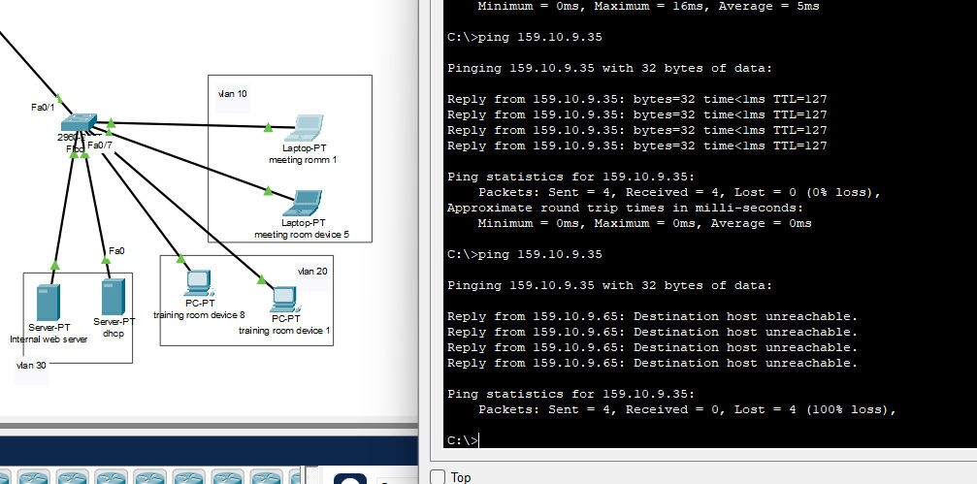
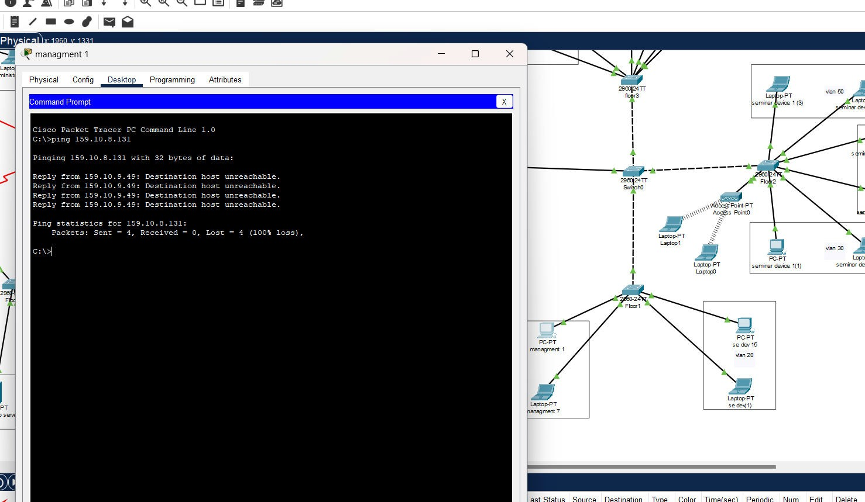
Final Testing
Test network functionality, security, and connectivity:
Before and after applying the ACL on Router Sub-Interfaces

Slide 13
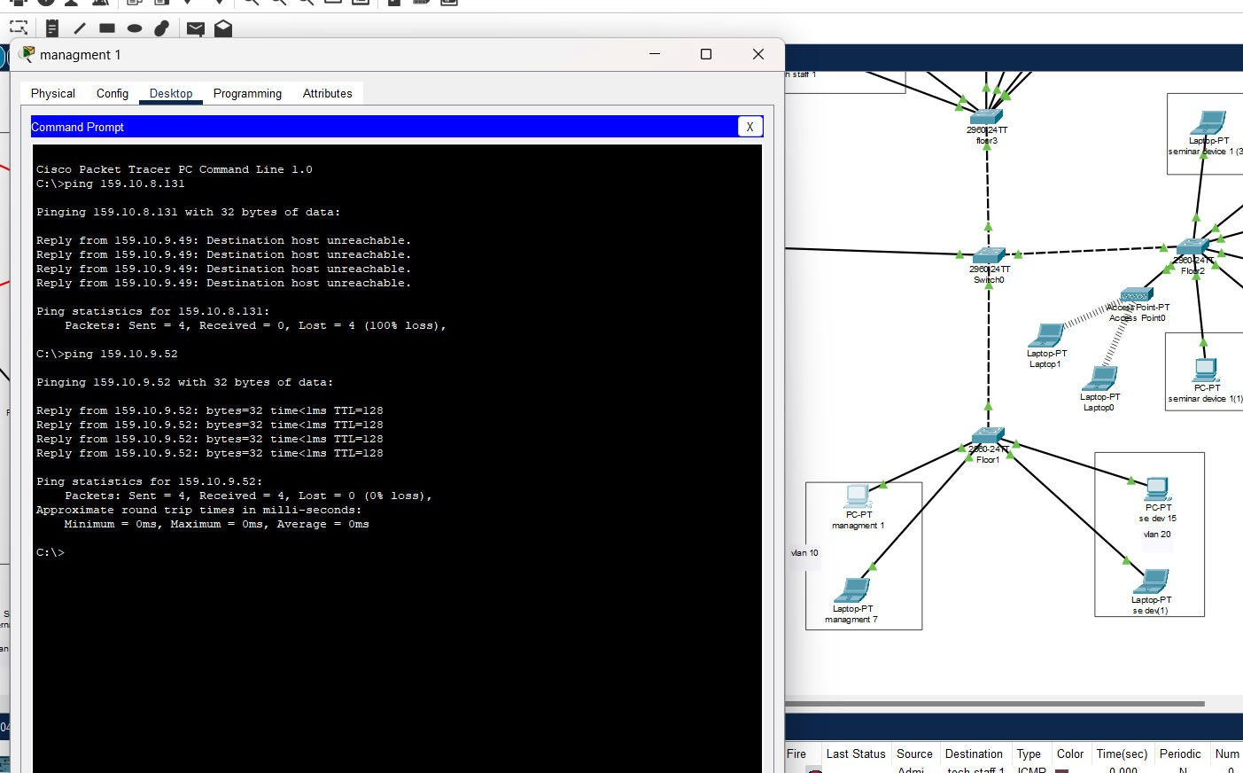
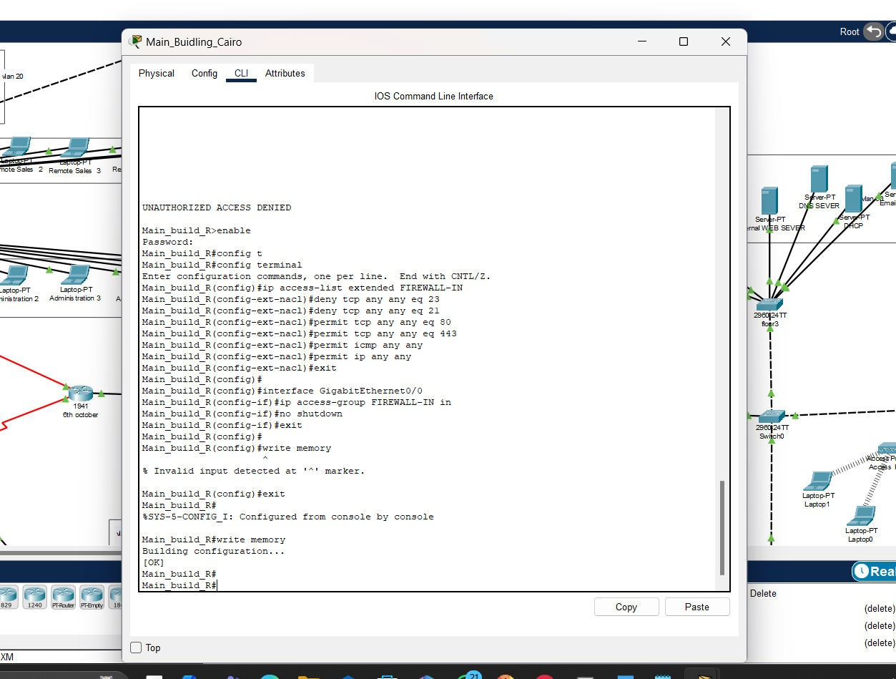
Connectivity between same Vlan ex Vlan 10:
Firewall rules and security policies script :

